Slide 1
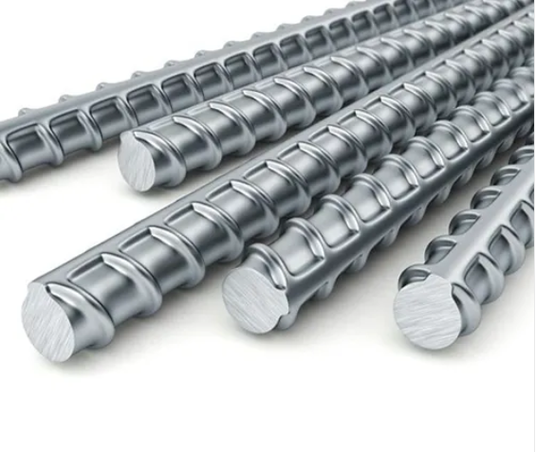

Inventory of TMT Steel Rods

Slide 2


Project Leadership
Sharat Manikonda
Director at Innodatatics and Sponsor
linkedin.com/in/sharat-chandra
Bharani Kumar Depuru
Director at Innodatatics
https://www.linkedin.com/in/bharanikumardepuru/

Slide 3
Team Members
Name: Krishna Vishwakarma
https://www.linkedin.com/in/krishna-vishwakarma-1b75aa247/

Slide 4

Contents
Project Overview and Scope
Project Goals and Objectives
CRISP – ML(Q) Methodology
Technical stacks
Project Architecture
Data Collection and Understanding
Data Dictionary
System Requirement
EDA (Exploratory Data Analysis)
Data Visualization for TMT
Challenges
Future Scope
Notes:
Change

Slide 5
Project Overview
The project undertaken during the financial year 2017 – 2023 it involves the collaboration of multiple contractors who have participated and shown interest in procuring materials for various customers. The material used in the project exbition diverse specification, including different diameter and grades with length

Slide 6
Business Problem
A lot of offcuts of steel rods are underutilized. Eventually these are sold as scrap leading to loss of revenue. Understanding the sales performance and pattern within the specified period of 6 years . The company needs to identify customers and their contribution to sale, evaluate the performance of different products grade, type and comprehend customer preferences for specific diameter and type(500D, 550D). So company aims to identify growth opportunity and area for improvement.
Objective | Constraints
Maximize utilization of offcuts & inventory. | Minimize the manual calculations on using inventory.

Slide 7
Project Goals and Objectives
Goals
Optimize the utilization of offcuts and inventory of steel rods
Effective Resource Utilization
Minimize scrap losses
Objectives
Monitored and analyzed the rates of materials bought by contractors. Cost effective options for materials within each diameter group.
Quantity and length requirements of materials based on diameter. Optimized the quantity and length of materials to minimize the waste.
Performance of contractors in terms of rates, quantities and timely nature of orders. Analyzing trends in material in usage, costs

Slide 8
CRISP-ML(Q) Methodology – Cross Industry Standard Process for Machine Learning with Quality
1(a) – Understand business problem and charter
(b) – data understanding
3-Data preprocessing / EDA
4-Data Visualization / Dashboard / Analysis
2 -Data collection / Data understanding / Data dictionary

Slide 9




Technical Stacks
Dataset
Datasbase Server
EDA
Data Visualization

Slide 10






Project Architecture
Business Problem
Business Objectives, Constraints and success criteria
Data Collection
Loading Data in Database servers and performing Data preprocessing and EDA
Importing clean data to perform visuals and built report
Performing AutoEDA and Data Prep on raw data

Slide 11
Data Collection and Understanding
Data is received in .xlsx format which is shared by client.
Data contains total six year records.
It is collected by order dates for every steel rods as per there quantity, rate, diameter, length, and type of rods.
The data fields contains of 10 features and 33045 records.
Data contain of different columns which are date, fy (financial year), customer name, dia (diameter), dia group(diameter group), grade, type, length, quantity, rate.

Slide 12
Data Information
Data source received is in .xlsx format
Dataset is all about TMT Steel rods and there records.
It contain 33045 rows and 10 features.
Extracted the data directly in PostgreSQL database.

Slide 13
Data Dictionary
Feature | Description | Range | Data Types
date | 6 Year data | Mar - 2017 to Mar-2023 | Date
fy | Financial Year | FY 18 – FY 23 | Object
customer Name | There are 1016 unique contractors records there transactions. | Contractor -0 to Contractor - 999 | Categorical
dia | Dia is diameter of rods that are sold by the contractors | 6MM to 36MM | object
dia_group | There are diameter of rods divided into there groups | 6MM, 8MM, 10MM, 12MM- 32MM, 28MM | object

Slide 14
Data Dictionary
Feature | Description | Range | Data Type
grade | Steel grades to classify various steels by their composition and physical properties | 500D & 550D | Object
type | Different type of rods according to there nature | COIL, CAB, CRSD, Full length, Short length | Object
length | Different lengths of rods nothing but size of rods. | 0 meter,4-7 meter,7-10meter,10-12 meter, customised | Object
quantity | Amount of order quantity recorded per metric ton | -32.34 to 41.68 | Numeric Continuous
rate | Rate of those rods per metric ton | 19590 to 83000 | Numeric Continuous

Slide 15
System Requirements
RAM (Memory) :- 12 GB
CPU :- AMD Ryzen 3 3250U with Radeon Graphics 2.60 GHz
System type :- 64-bit operating system
Operating System :- Windows 11 Pro
Python Version 3.10
Anaconda software to launch IDE platforms like Jupiter Notebook and Spyder
PostgreSQL 15
Microsoft Power BI
Notes:
Table change

Slide 16

EDA(Exploratory Data Analysis)
Exploratory Data Analysis (EDA) is a process of describing the data by means of statistical and visualization techniques in order to bring important aspects of that data into focus for further analysis. This involves inspecting the dataset from many angles, describing & summarizing it without making any assumptions about its contents.

Slide 17
Missing Values Observation
There was total 30 missing values presented in all over data.
Mainly in quantity column there 14 missing values and rate column 16 missing values.
So treat those missing value we used median imputation because it standard practice also doesn’t get affected by outliers.
So median value for quantity is 3.9 and for rate 45700.

Slide 18
Data Description
Total no of Rows | 33045
Total no of columns | 10
Total numerical columns | 2
Total categorical columns | 7
Total Distinct Financial Year | 6 Year (2018-2023)
Total Distinct customer | 1016
Total Distinct Diameter | 10 (6MM, 8MM, 10MM, 12MM, 16MM, 20MM, 25MM, 28MM, 32MM, 36MM)
Total Distinct Grade | 2 (500D,550D)
Total Distinct Type | 5 (CAB, COIL, CRSD, Full Length, Short Length)
Total Distinct Length | 6 (0Meter, 4-7Meter,7-10Meter, 10-12Meter, 12Meter, Customized )
Total Distinct Rate | 1126
Total Distinct Quantity | 3751
Total Null Values within columns | Quantity |  |  | Rate
 | 14 |  |  | 16
Total Duplicate values within columns | 35
Mean of numerical columns | Quantity | Rate
 | 5.9 | 48521
Median of numerical columns | Quantity |  | Rate
 | 3.9 |  | 45700
Variance of numerical columns | Quantity |  | Rate
 | 44.5 |  | 92924836.70
Standard deviation of numerical columns | Quantity |  | Rate
 | 6.67 |  | 9639.75
Maximum & Minimum Diameter | Max |  | Min
 | "06 MM" |  | "36 MM"
Maximum & Minimum Grade | Max |  | Min
 | 500D |  | 550D
Maximum & Minimum Quantity | Max |  | Min
 | 41.68 |  | -32.34
Maximum & Minimum Rate | Max |  | Min
 | 83000 |  | 19590
Notes:
Keep observations

Slide 19
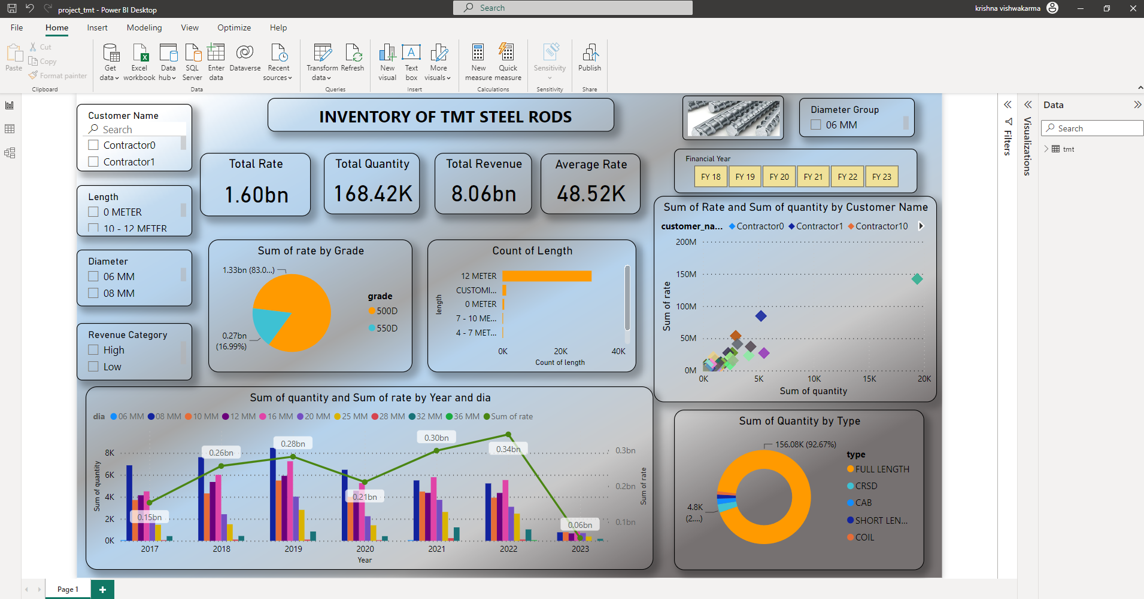
Data Visualization for TMT

Slide 20
Challenges
The Measure challenge was to getting error while importing dataset into the PostgreSQL due to date column.
Connecting PostgreSQL server to Power BI Desktop is challenging due to server connection issue.
Installation of module in python tool was difficult.
Notes:
Add graphical

Slide 21
Future Scopes
Optimize inventory management by using demand forecasting models to ensure optimal stock levels and minimize holding costs.
Implement a customer feedback system to gather insight on product quality, customer satisfaction, and areas for improvement.
Leverage digital marketing channels and social media platforms to expand the customer base and reach a wider audience.
Explore cross- selling and upselling opportunities by analyzing customer purchase patterns and preferences to maximize revenue from existing customers.
Notes:
Piee

Slide 22


